Slide 1

PHISHING SITES PREDICTION USING MACHINE LEARNING Chiru deepika yalamanchili(811300581) Raghunath Male (8112572266) Suresh Babu Nakkalapalli (811292428)

Slide 2
Agenda
Introduction
Originality
Data Collection
Approach
Methodologies
Future Work
Benefits
References

Slide 3
Introduction:
The project's main objective is to increase the predictive power of phishing websites through the application of machine learning techniques.
The goal of the project is to employ machine learning techniques to detect and stop phishing assaults on websites.
It involves the extraction of relevant features, collection of datasets comprising both phishing and legitimate websites, and training machine learning models.
The project's main goal is to use machine learning techniques to increase the prediction accuracy of phishing websites.

Slide 4

PHISHING INTRODUCTION :
The fraudulent practice of sending emails purporting to be from reputable companies to induce individuals to reveal personal information, such as passwords and credit card numbers
MOTIVES: Financial gain, damage reputation, identity theft, fame & notoriety
Phishing websites indicators:
Visually appears like the original website
Email creates a sense of urgency to force user action
Fake HTTPS certificate & domain name
Provides attractive offers which tempts the user to respond

Slide 5
Originality:
This project is unique because it makes finding phishing websites much faster. While people might take hours to check one website, the new machine learning method can check thousands of websites in the same time. This makes the detection process much quicker and more efficient, using the power of machine learning to overcome the challenges and time limits of manual detection methods.
Our project uses machine learning to analyse a lot of data in a smart way, going beyond simple rule-based systems. The algorithms can understand tricky patterns in phishing attacks and get better over time. This is important because cyber threats keep changing and getting more complicated.

Slide 6
Data collection:
Our dataset consists of two columns: “URL” and “Label.”
Link:- https://www.kaggle.com/datasets/taruntiwarihp/phishing-site-urls
URL Column:
This column contains 5,49,347 URLs.
Each row represents a unique web address (URL) with classification as either "good" or "bad" (potentially indicating phishing).
There are around 3,80,000 good URLs and 1,60,000 bad URLs.
Label Column:
This column contains corresponding labels for each URL.
There are two distinct labels: "good" and "bad.“
A. Good - which means the URLs is not containing malicious stuff and this site is not a Phishing Site. B. Bad - which means the URLs contains malicious stuff and this site is a Phishing Site

Slide 7
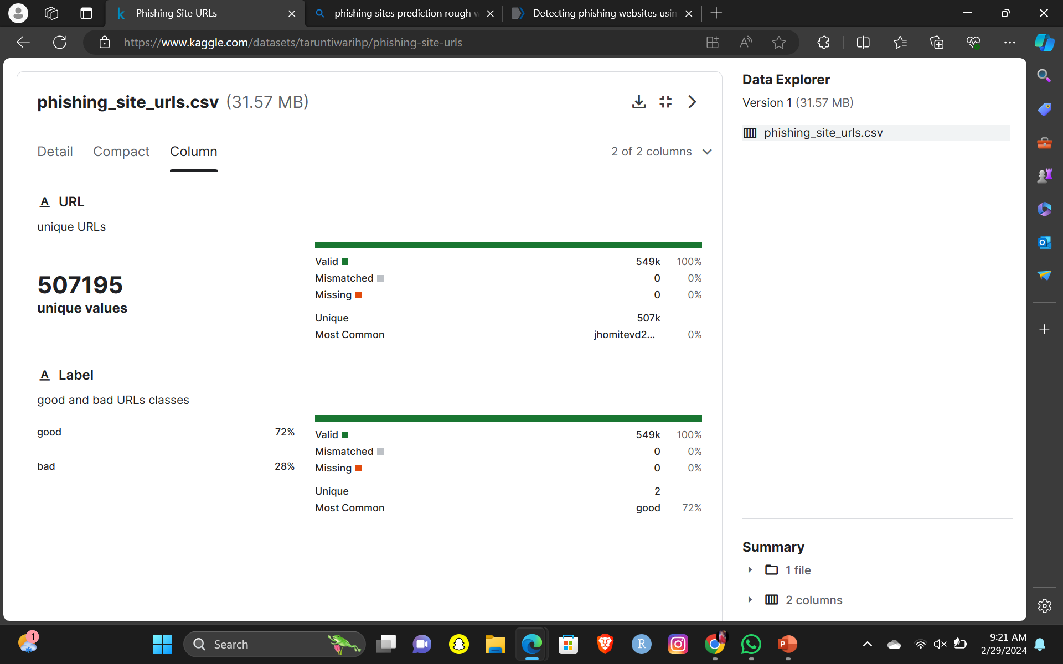

Slide 8
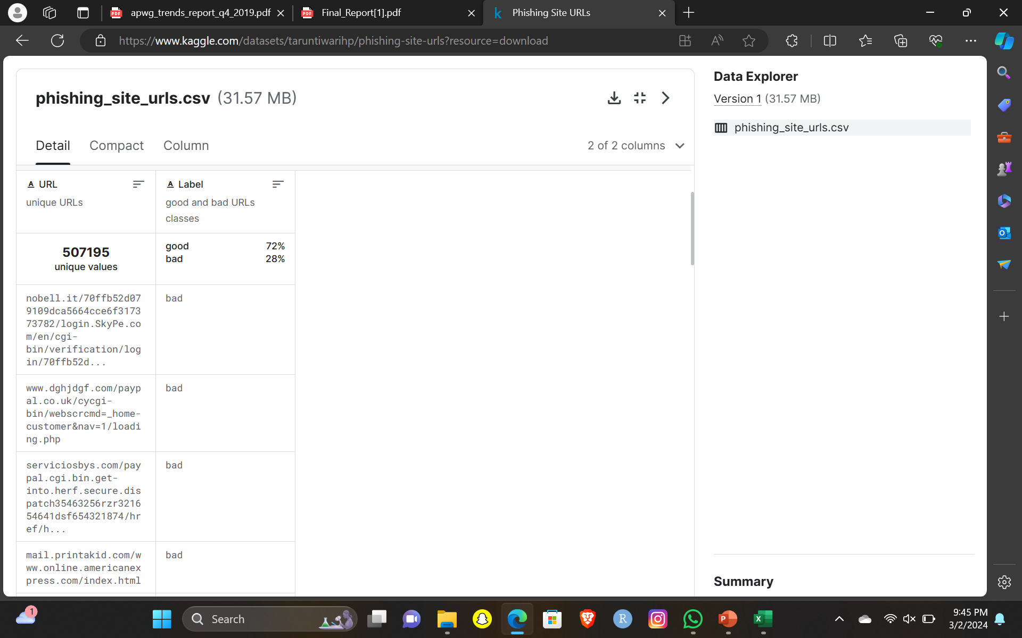
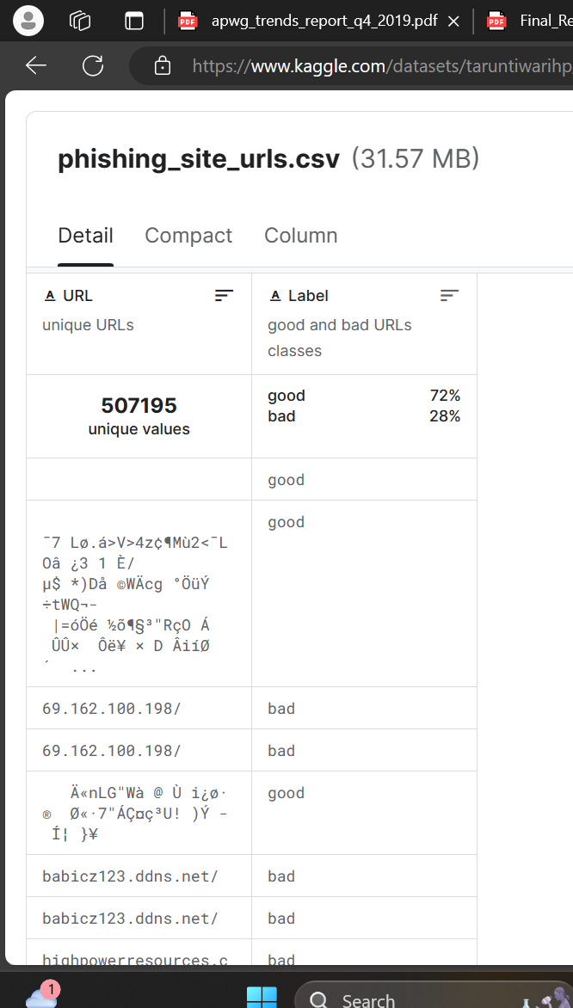

Slide 9
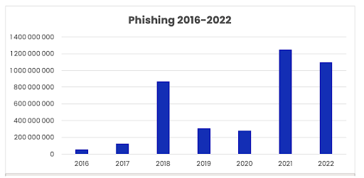
These data consist of a collection of legitimate, as well as phishing website instances. Each website is represented by the set of features that denote whether the website is legitimate or not. Data can serve as input for the machine learning process.
Machine learning and data mining researchers can benefit from these datasets, while also computer security researchers and practitioners. Computer security enthusiasts can find these datasets interesting for building firewalls, intelligent ad blockers, and malware detection systems.
This dataset can help researchers and practitioners easily build classification models in systems preventing phishing attacks since the presented datasets feature the attributes which can be easily extracted.
Finally, the provided datasets could also be used as a performance benchmark for developing state-of-the-art machine learning methods for the task of phishing websites classification.

Slide 10
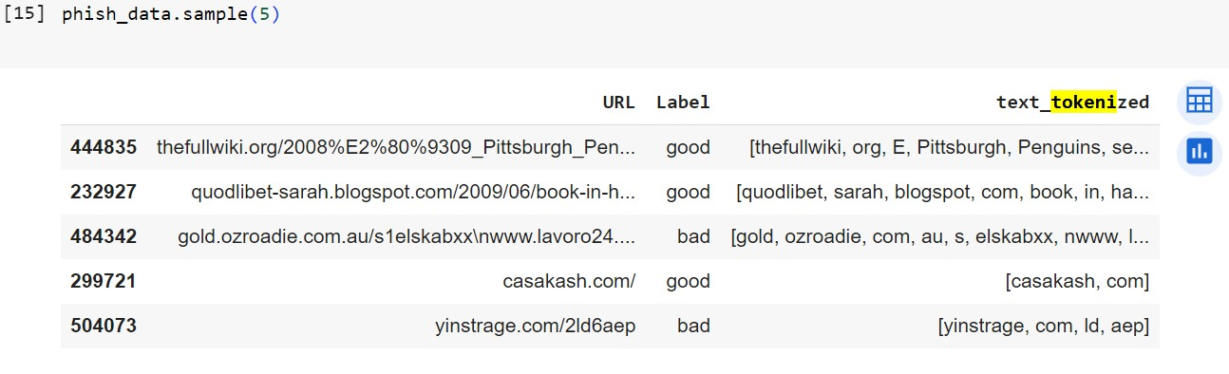
Approach:
Data Preprocessing:
Loaded the dataset using Pandas.Explored and visualized the dataset.
Applied tokenization and stemming to preprocess the URL text using NLTK.
Utilized regular expressions (‘RegexpTokenizer’) to tokenize words in URLs.
Applied stemming using the ‘Snowball Stemmer’ for reducing words to their base form.
Joined the tokenized and stemmed words back into a text representation.
The preprocessing step is crucial for converting raw URLs into a format suitable for machine learning.

Slide 11
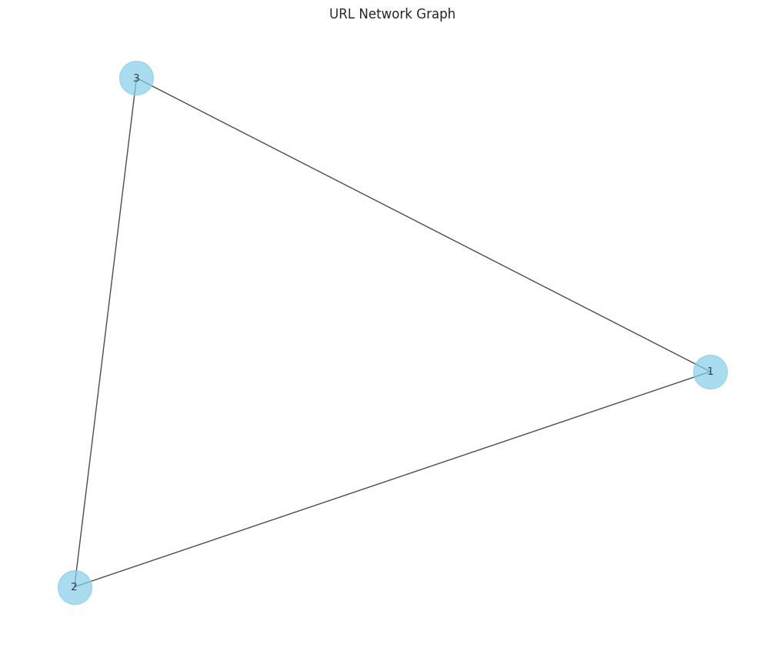
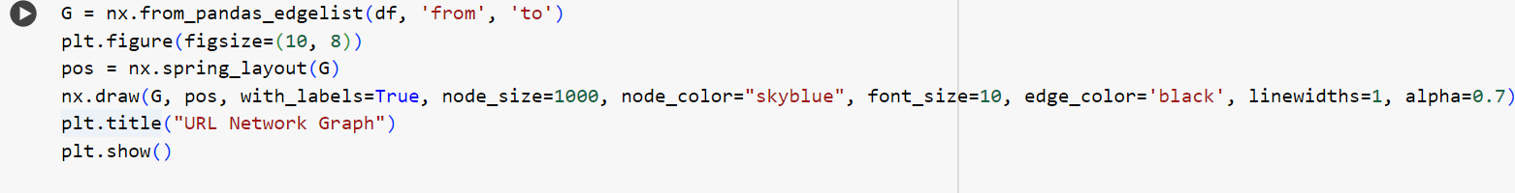
Web Scraping and Network Analysis:
Utilized Selenium and Beautiful Soup for web scraping to collect links from specified URLs.
Created a network graph using Network X to visualize relationships between URLs.
Create a network graph to visualize the links between different URLs

Slide 12
Model Training and Evaluation:
Trained machine learning models, including Logistic Regression and Multinomial Naive Bayes, on preprocessed data.
Evaluated model performance using accuracy scores, confusion matrices, and classification reports.
Visualized model accuracies using Matplotlib and Seaborn.

Slide 13
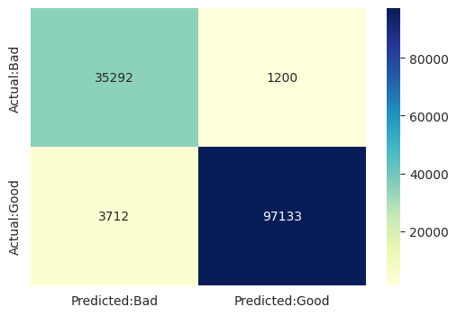
Confusion Matrix:
The confusion matrix gives a detailed breakdown of the model's predictions, providing insights into its true positives, true negatives, false positives, and false negatives.

Slide 14
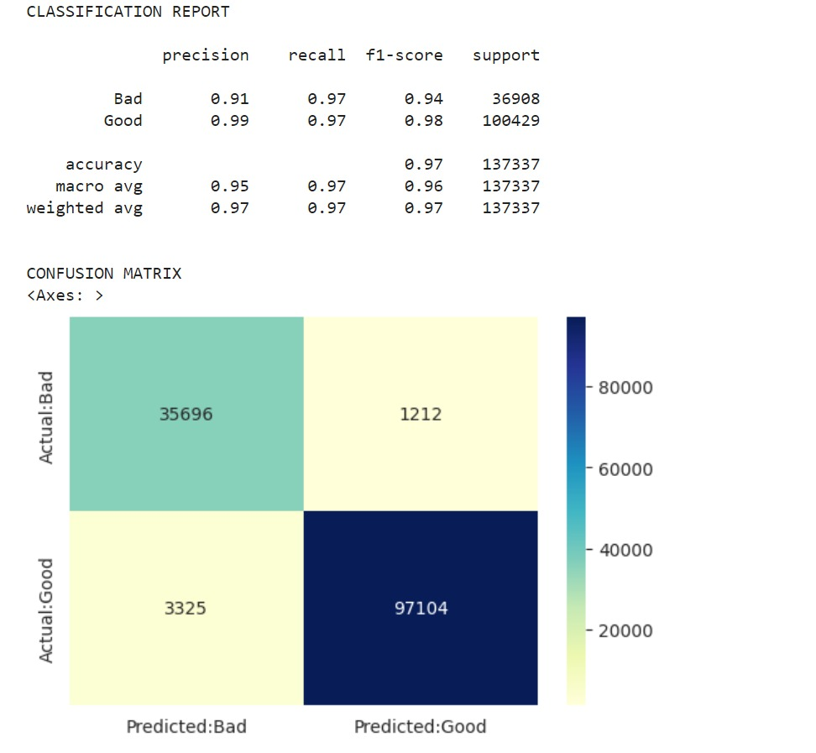

Slide 15
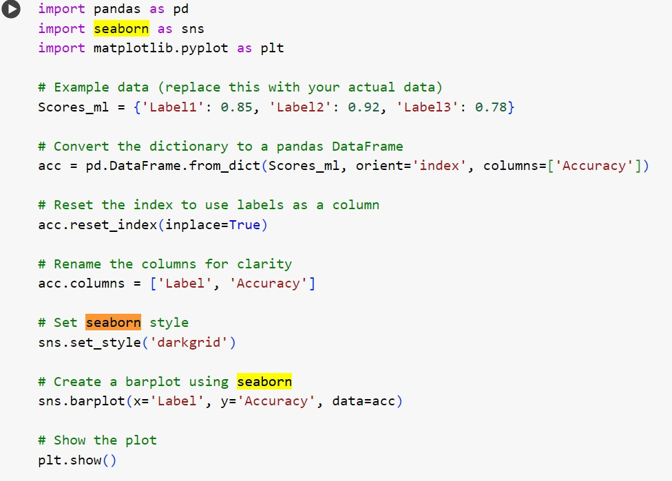
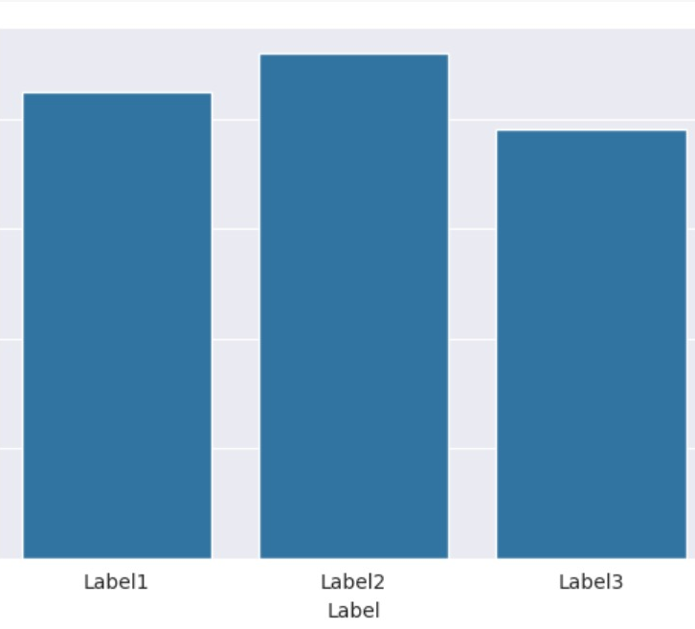

Slide 16
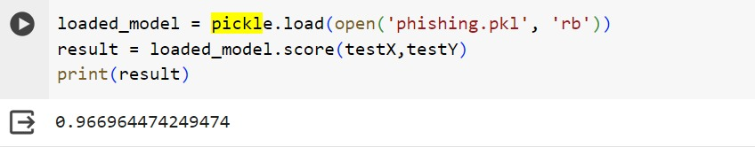
Model Deployment and Prediction:
Saved and loaded a pre-trained model using Pickle.
Tested the model on a test set.
Implemented a function to classify new URLs based on specific patterns.

Slide 17
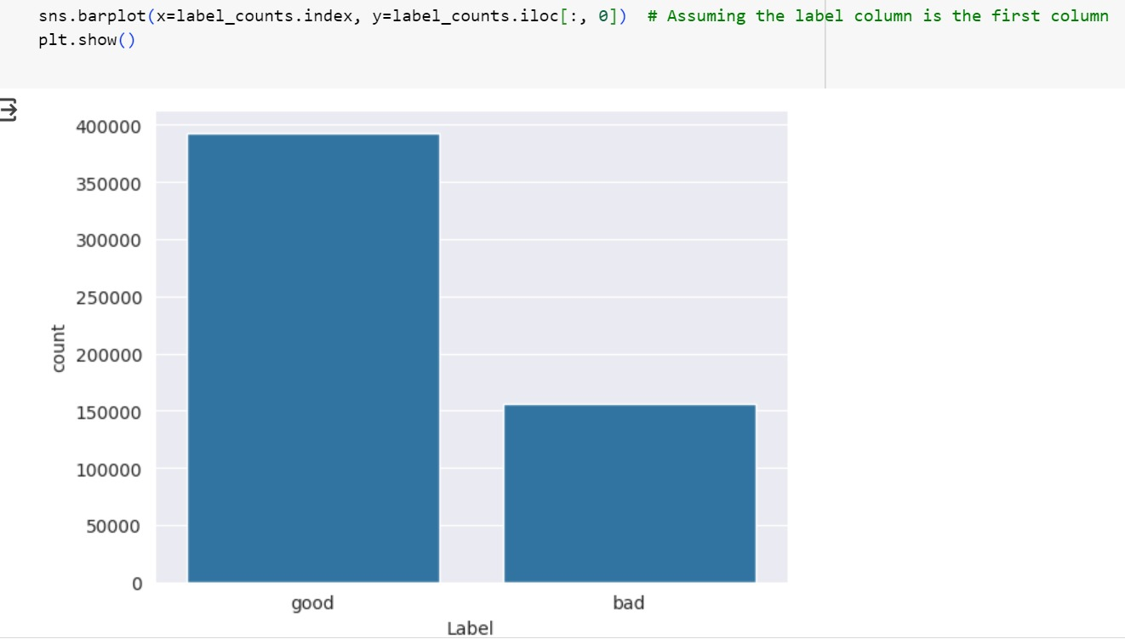
Predictions and Visualization:
Demonstrated model predictions on example URLs.
Visualized model accuracies through bar plots.

Slide 18
Methodologies :
Languages:
Python as primary programming language for its versatility in data analysis and web scraping.
Libraries and Technologies:
Pandas: For data manipulation and analysis, especially in loading and exploring the dataset.
NumPy: For numerical operations and efficient array handling.
Seaborn and Matplotlib: Employed for data visualization, generating plots and graphs for better understanding.
Scikit-Learn: Integrated for machine learning tasks, including model training, evaluation, and preprocessing.
NLTK (Natural Language Toolkit): Used for tokenization and stemming of URL text.
Selenium and Beautiful Soup: Applied for web scraping to collect additional links from specified URLs.
Network X: Utilized for creating and visualizing the network graph, providing insights into URL relationships.
Word Cloud: Potentially used for creating word clouds.
Pickle: Employed for saving and loading pre-trained machine learning models.

Slide 19
MACHINE LEARNING MODELS :
• This is a supervised machine learning task. There are two major types of supervised machine learning problems, called classification and regression.
• This data set comes under classification problem, as the input URL is classified as phishing (1) or legitimate (0). The machine learning models (classification) considered to train the dataset in this notebook are:
• Decision Tree
• Random Forest
• Support Vector Machines
Logistic Regression and Multinomial Naive Bayes: Implemented for predicting and classifying phishing sites.
Web Scraping:
Selenium WebDriver: Used for browser automation to interact with web pages.
Beautiful Soup: Applied for HTML parsing and extracting information from web pages.

Slide 20
Logistic Regression Model:
Overview:
Training Accuracy (Approx): 97.75%
Testing Accuracy (Approx): 96.42%
Logistic Regression is a versatile and widely used classification algorithm.
It's effective in binary classification tasks, making it suitable for your "phishing" or "not phishing" prediction.
Achieving high accuracy on both training and testing sets indicates that the model is well-fitted to the data.

Slide 21

Multinomial Naive Bayes Model:
Overview:
Training Accuracy (Approx): 97.41%
Testing Accuracy (Approx): 95.82%
Multinomial Naive Bayes is well-suited for text classification tasks, making it a good choice for the URL prediction problem.
It works well with features that represent word frequencies, which is common in natural language processing tasks.

Slide 22
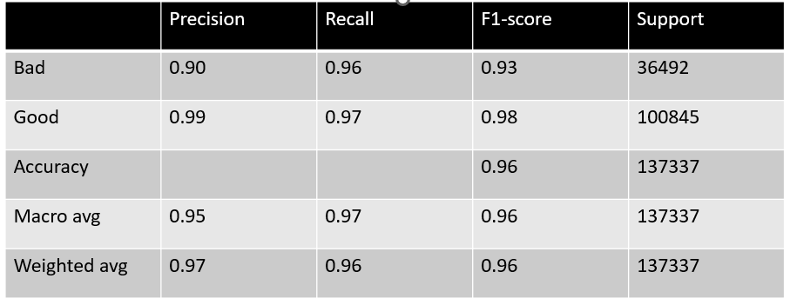
Classification Report:
Precision, recall, and F1-score for both "Bad" and "Good" classes are high.
This indicates that the model is not only accurate but also excels in correctly identifying positive and negative instances.

Slide 23
Future work:
User-Centric Phishing Prevention Extension: Developing a browser extension that integrates our phishing detection model to provide real-time alerts to users while they browse the internet. The extension can analyze URLs in the background and notify users if a website is potentially phishing. This user-friendly tool empowers individuals to make informed decisions about the websites they visit, contributing to a safer online experience. Additionally, consider incorporating user feedback features to enhance the model's accuracy and customization for individual user preferences. This extension could serve as a practical tool for personal cybersecurity, aligning with the growing need for user-centric solutions in the digital landscape.

Slide 24
FEATURE EXTRACTION :
Classification output: 0 = legitimate, 1 = phishing.
1.having_IP_Address 7. having Sub_Domain 13. Request URL 19. Site Redirect
2. URL Length 8. SSL State 14. URL_of_Anchor 20. on_mouseover_changes
3. Shortening Service 9. Domain_registeration_length15. Links_in_tags 21. RightClick_Disabled
4. having At_Symbol 10. Favicon 16. Server_Form_Handler 22. popUpWindow
5. double_slash_redirecting 11. Open_ports 17. Submitting_to_email 23. Iframe_redirectionTHIS DAY IN HISTORY
6. Prefix Suffix 12. HTTPS_token_in_URL 18. Abnormal_URL 24. age_of_domain
25. DNS_Record 26. web_traffic_rank 27. Page_Rank 28. Google_IndexWith a SoFt Personal with no fees required
29. Links_pointing_to_page6. Prefix Suffix 30. Statistical_report-to phishing domains

Slide 25
BENEFITS :
Reduce dependency, cost & license on third-party external software
Re-use of in-house org's data rather than contribute towards improving commercial software
Better insights into online behavior of employees
Real-time protection for employees who access malicious websites or click on phishing links
Detect and prevent against unknown phishing attacks, as new patterns are created by attackers
Next level of intelligence on top of signature-based prevention techniques & blacklists
Email filtering solutions help in filtering phishing/spam emails, but this provides holistic protection for all outgoing internet traffic
Centralized solution implemented org-wide and no dependency on client-side agents/software
Anti-phishing: move from real-time to offline; move from reactive to proactive

Slide 26
References :
Sudhanshu Gautam, Kritika Rani and Bansidhar Joshi: Detecting Phishing Websites Using Rule-Based Classification Algorithm: A Comparison: In Springer,2018.
2) Luong Anh Tuan Nguyen, Ba Lam To, Huu Khuong Nguyen and Minh Hoang Nguyen: Detecting Phishing Web sites: A Heuristic URL-Based Approach: In The 2013 International Conference on Advanced Technologies for Communications (ATC'13).
3) M. Amaad Ul Haq Tahir, Sohail Asghar, Ayesha Zafar, Saira Gillani: A Hybrid Model to Detect Phishing-Sites using Supervised Learning Algorithms: In International Conference on Computational Science and Computational Intelligence IEEE ,2016.
4) Ankit Kumar Jain, B. B. Gupta: Towards detection of phishing websites on client-side using machine learning based approach: In Springer Science + Business Media, LLC, part of Springer Nature 2017.
5) Routhu Srinivasa Rao1, Alwyn Roshan Pais: Detection of phishing websites using an efficient feature-based machine learning framework: In Springer 2018.
6) Ahmad Abunadi, Anazida Zainal, Oluwatobi Akanb: Feature Extraction Process: A Phishing Detection Approach: In IEEE,2013.

Slide 27
Thank you

